Slide 1
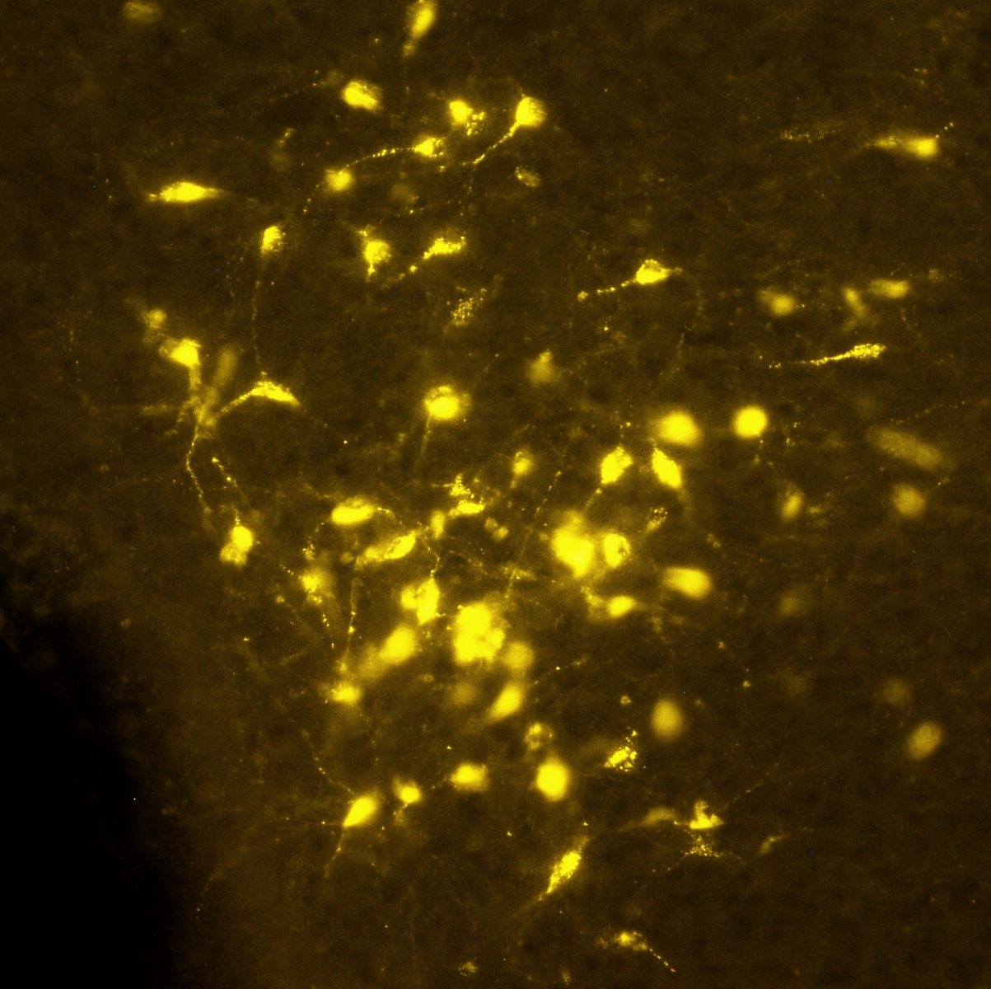
Track module 1 Basics of Image Processing and ML in Python
Ekaterina Golubeva
23.01.23

Slide 2
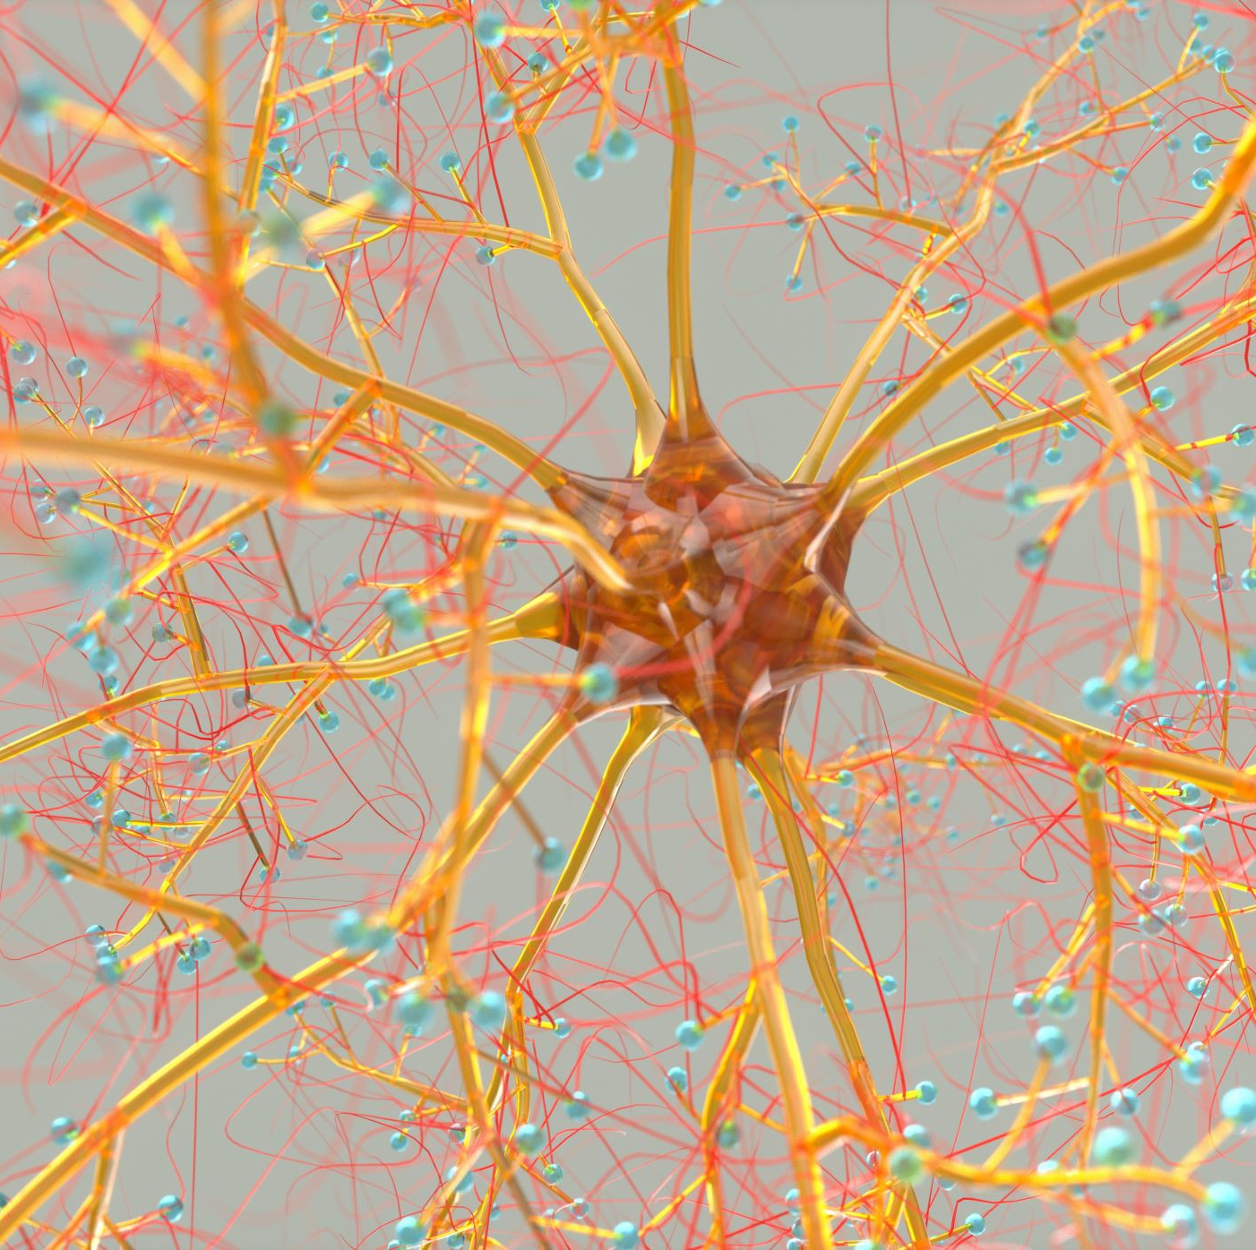
Plan
Image segmentation using fluorescent neuronal cells
Deep learning and Neural Networks overview
USZ visits overview

Slide 3
Recall the procedure for segmentation:
1) Feature extraction
2) Create ML model and validate it
3) Save the result
4) Segmentation of multiples images

Slide 4
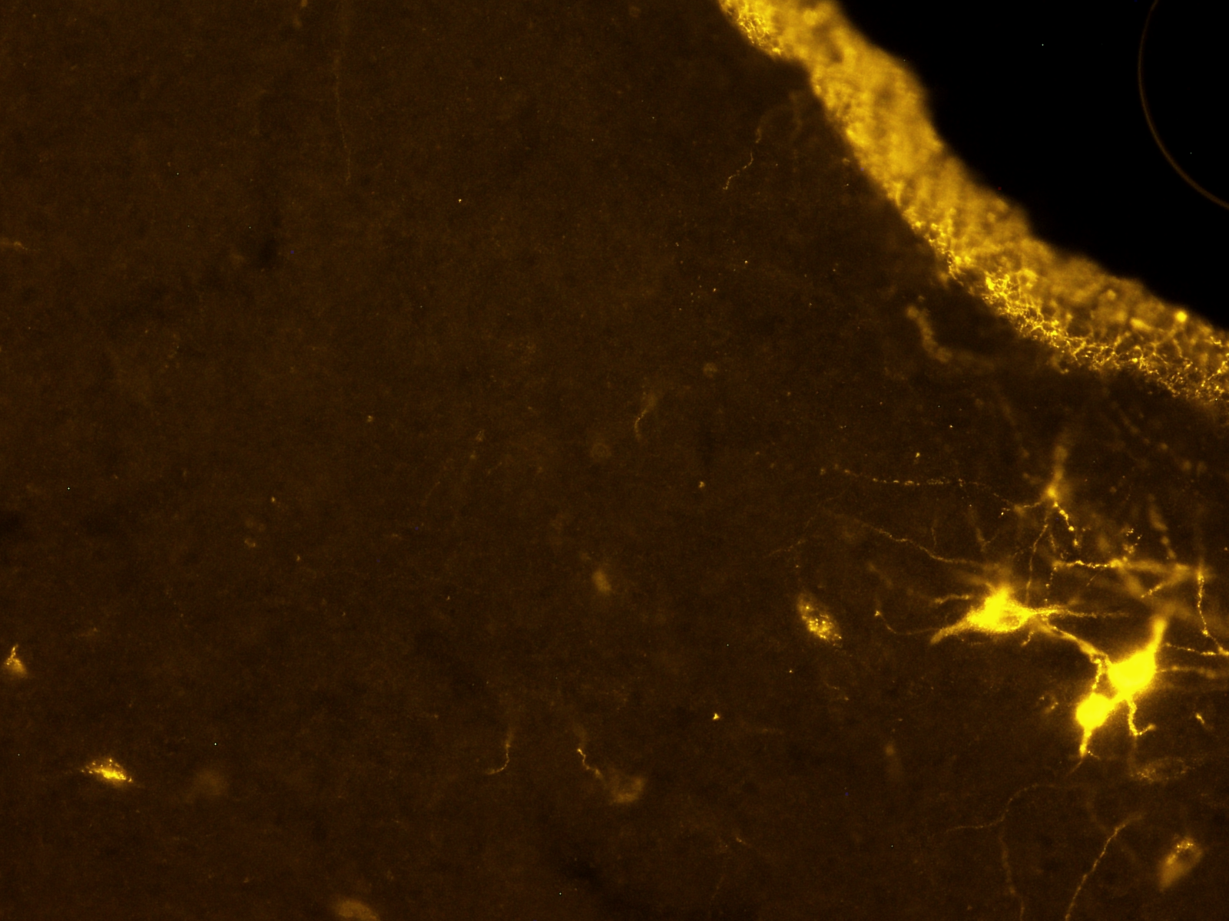
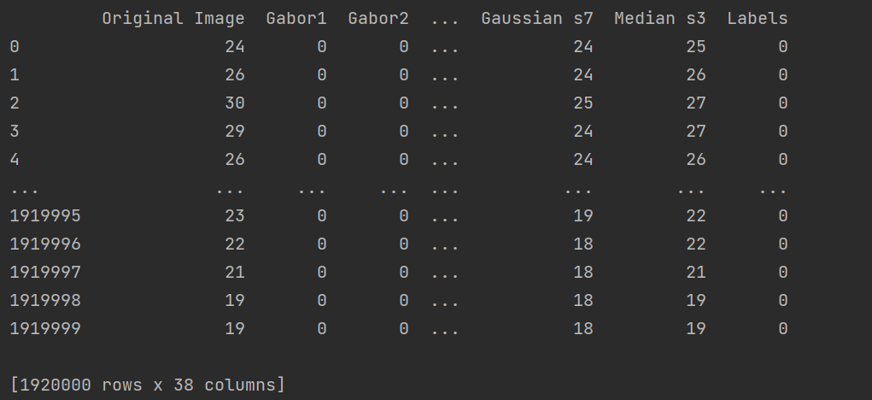
Feature extraction

Slide 5
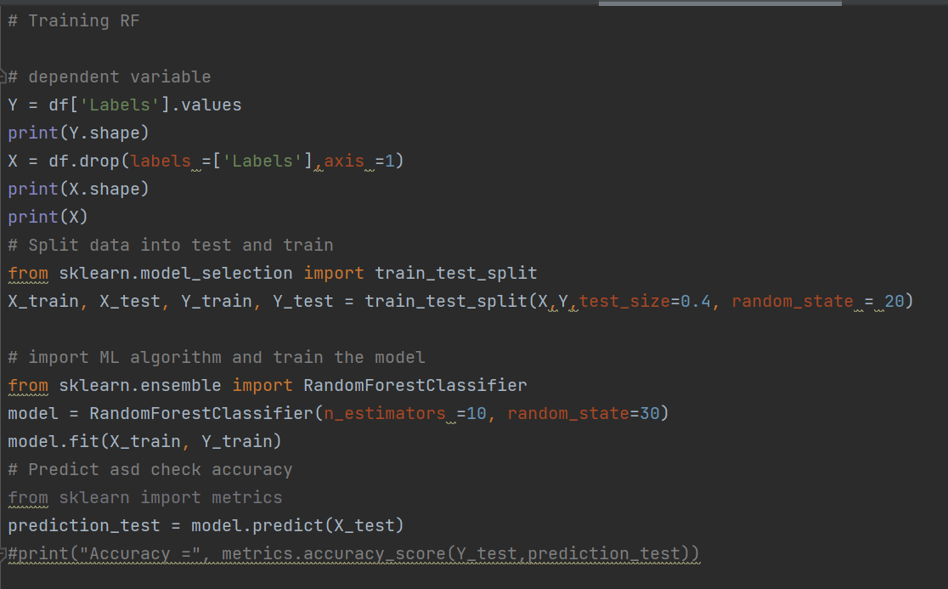
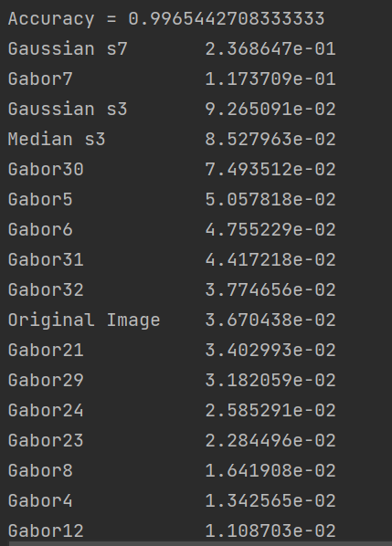
Train the Random Forest Classifier

Slide 6
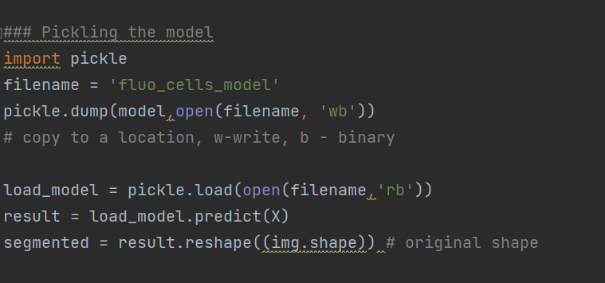
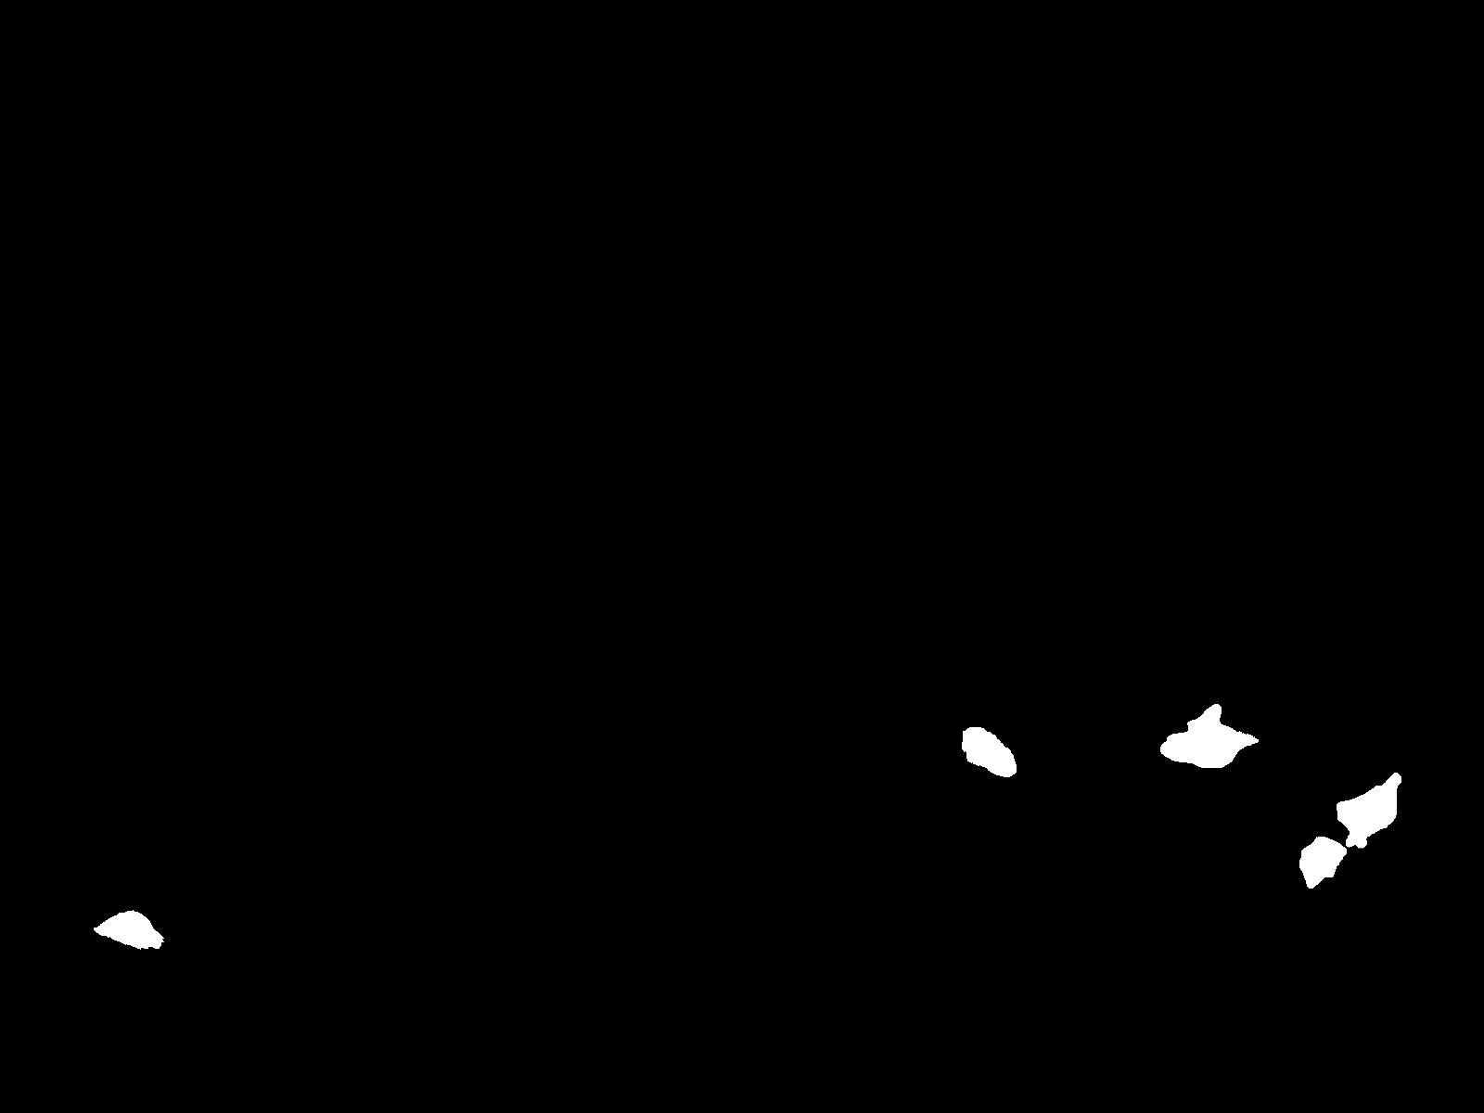
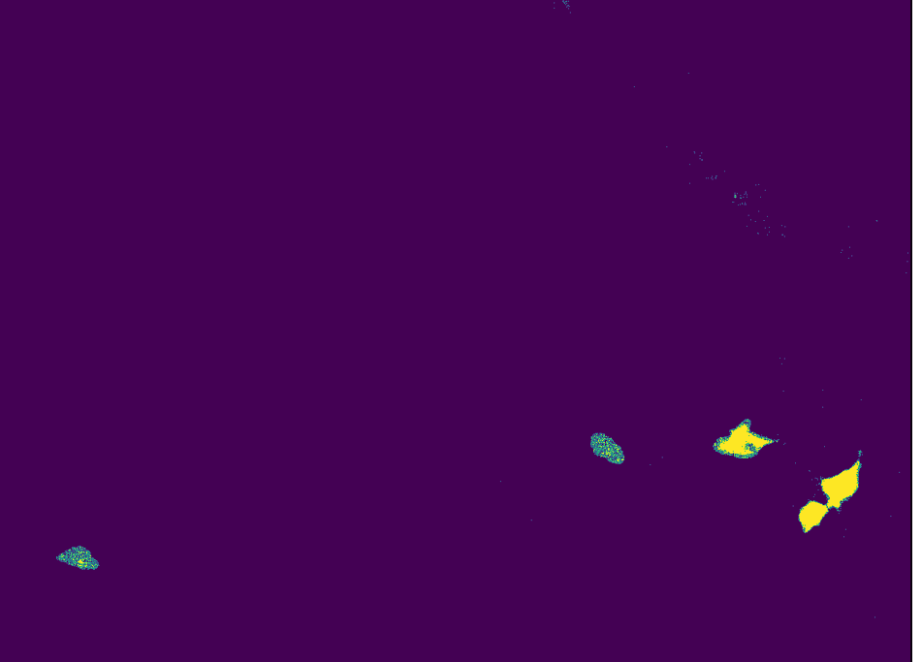
Evaluate the model and save it

Slide 7
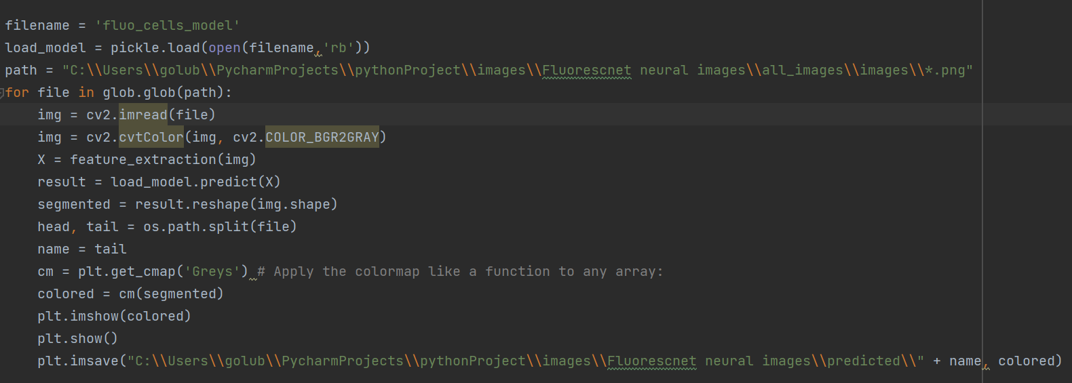
Apply the model on multiple images

Slide 8
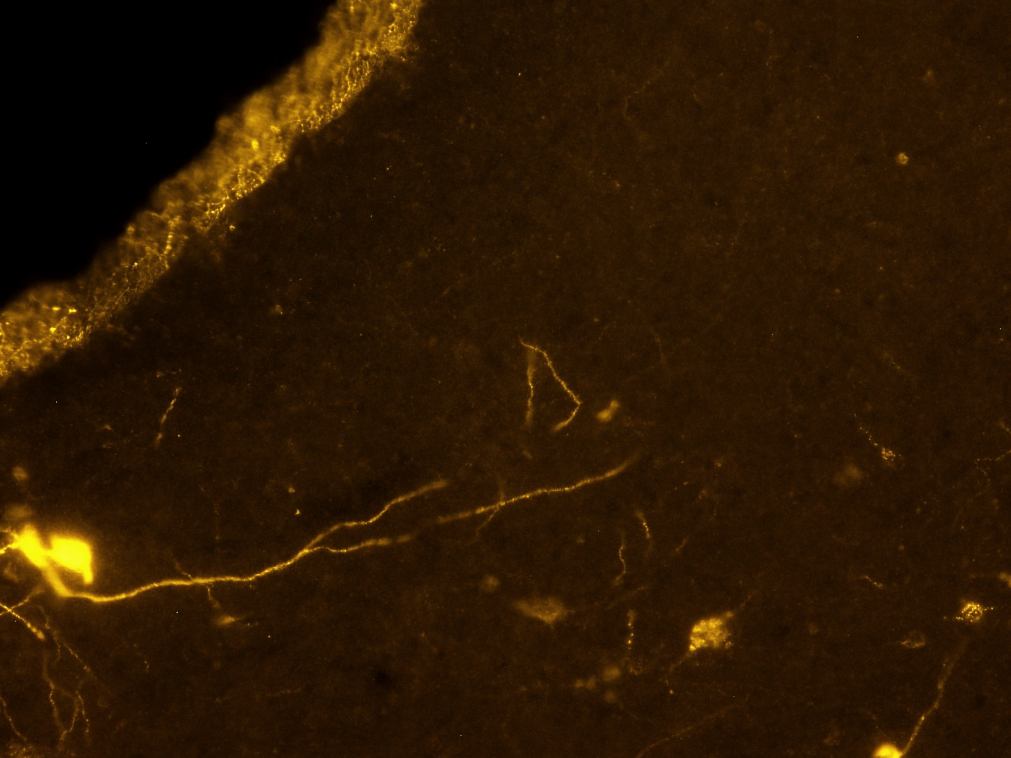
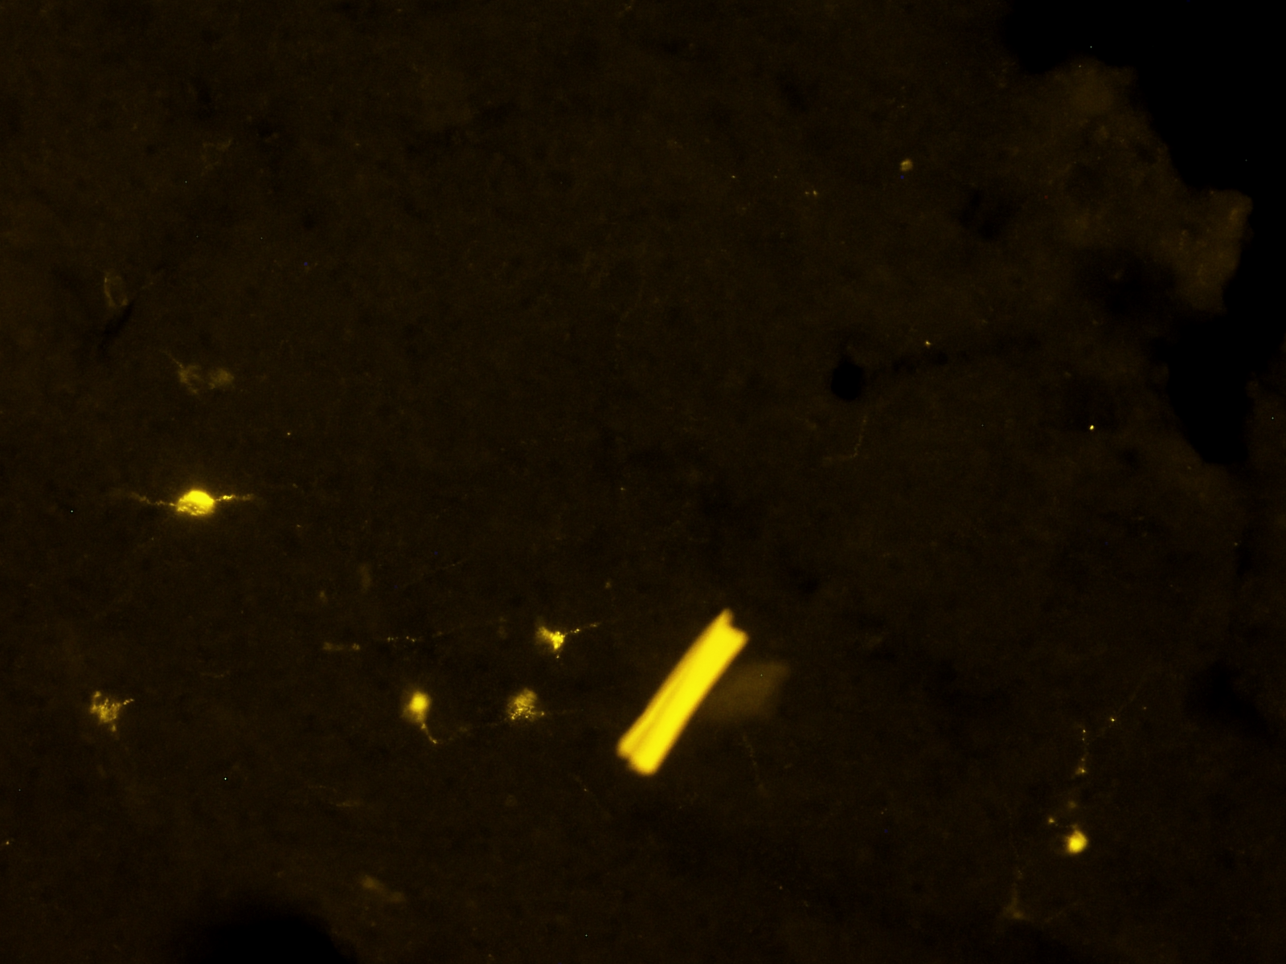
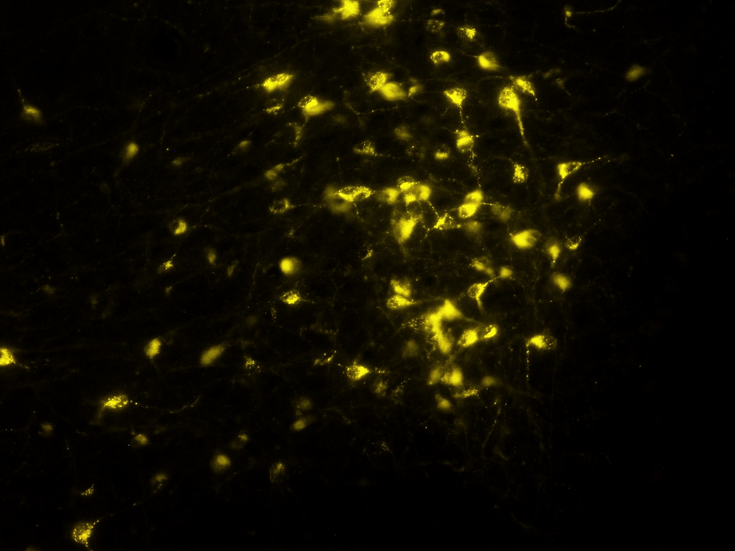
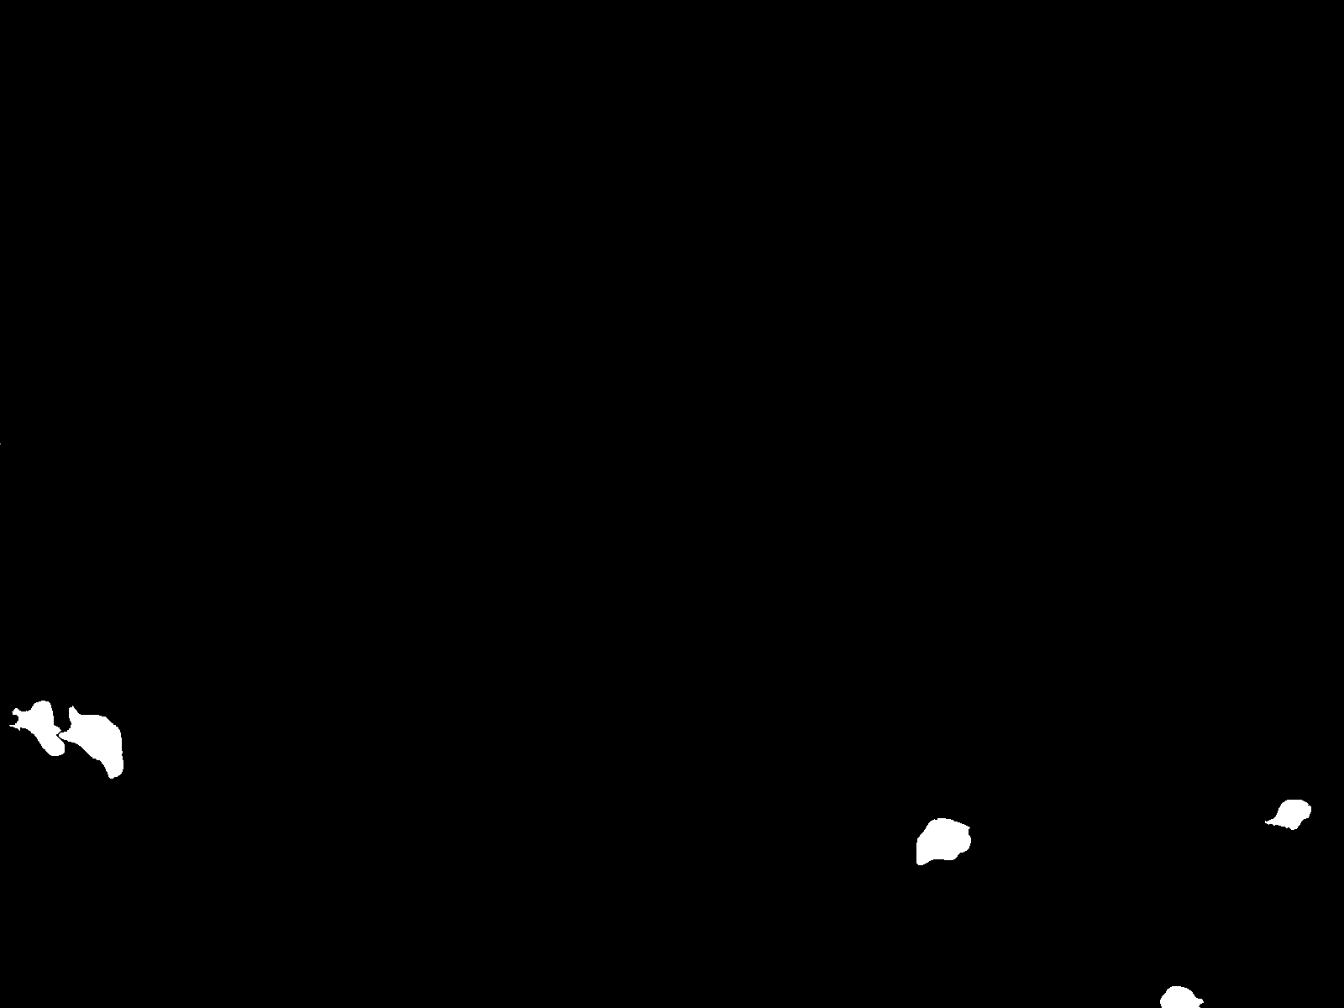
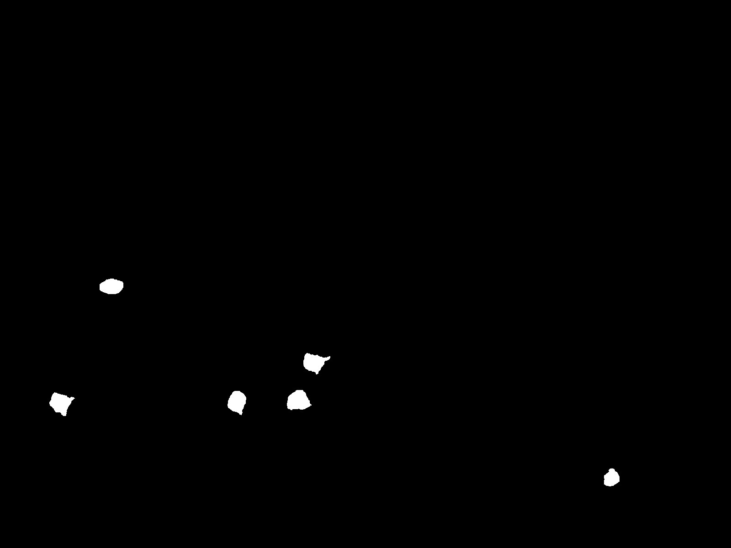
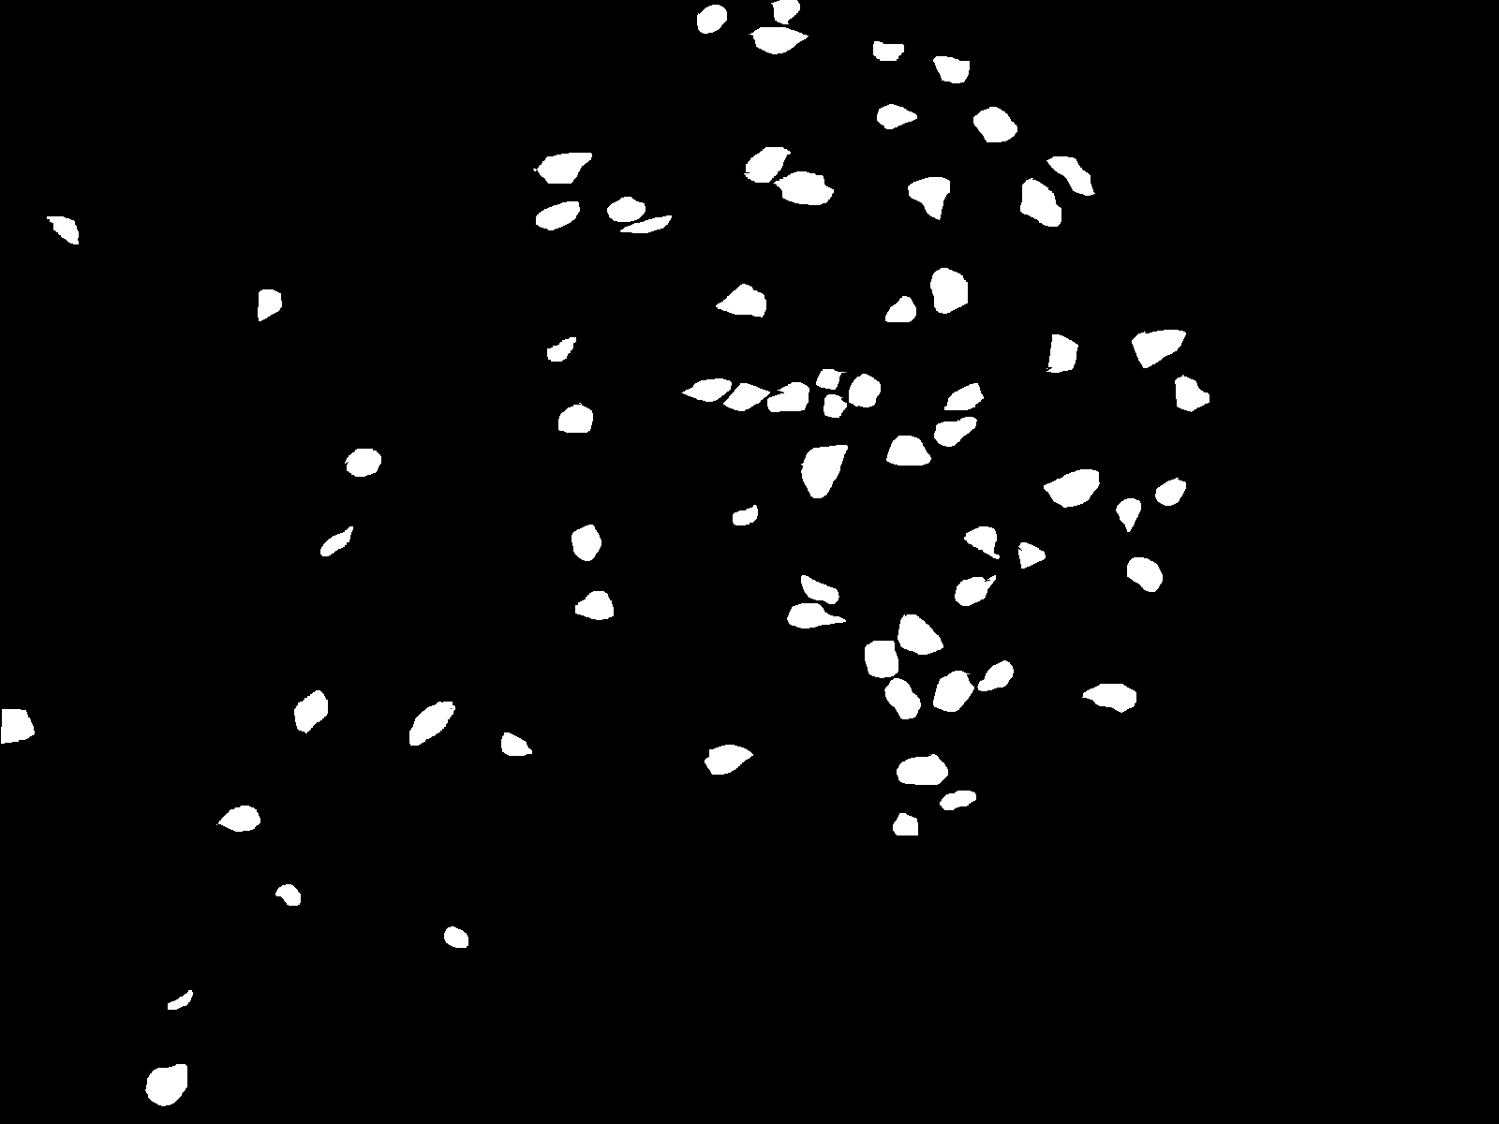
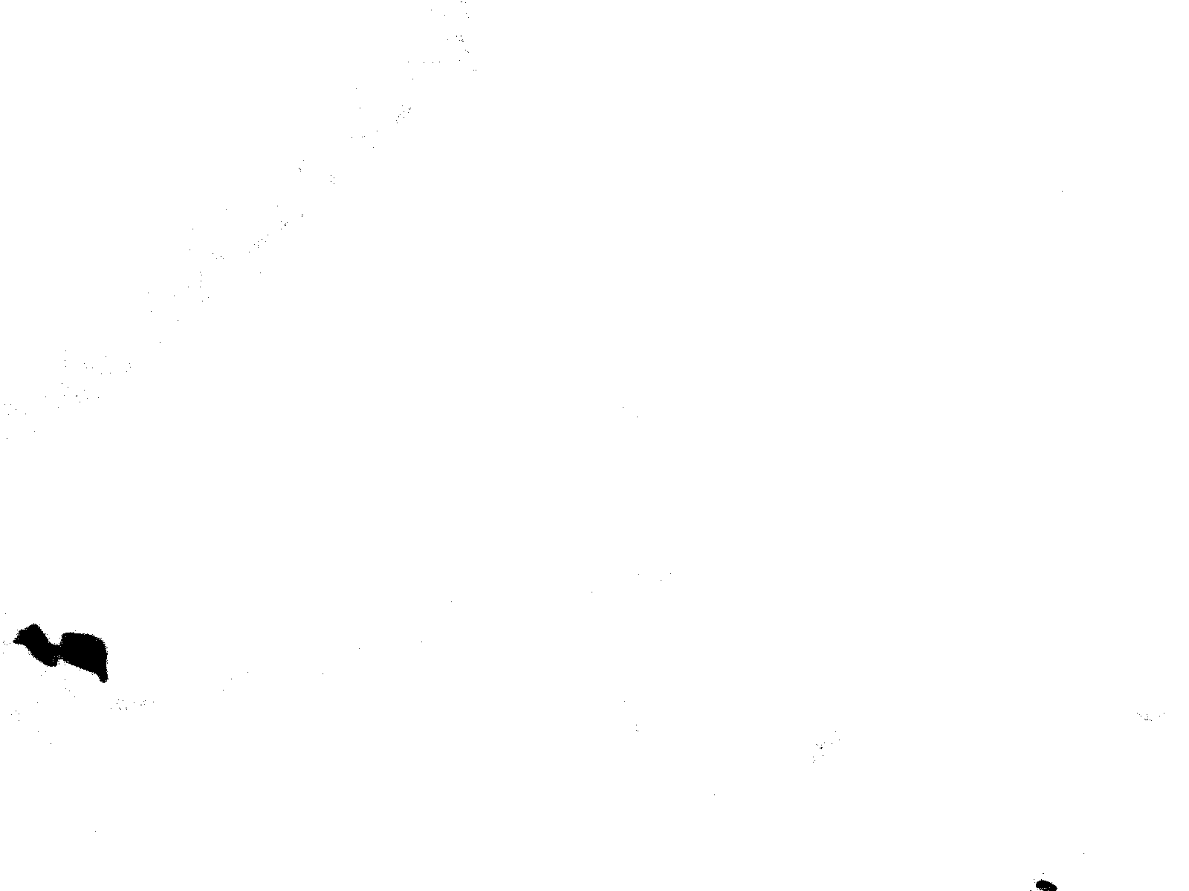

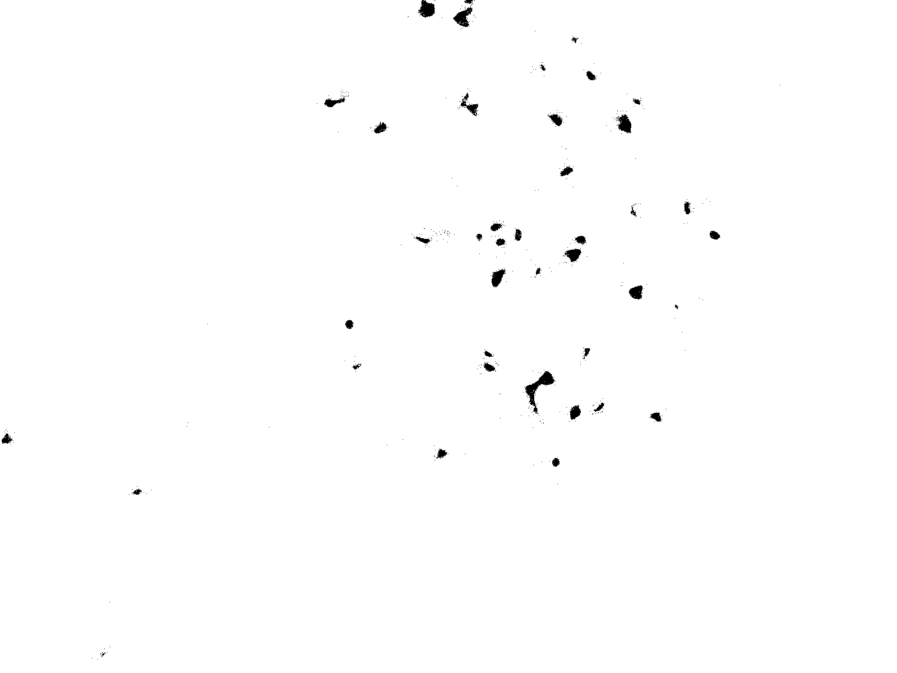
Original Label Predicted

Slide 9
Multi-training : Feature based segmentation using Random Forest using multiple training images
STEP 1: READ TRAINING IMAGES AND EXTRACT FEATURES
STEP 2: READ LABELED IMAGES (MASKS) AND CREATE ANOTHER DATAFRAME
STEP 3: COMBINE THE TWO DATSFRAMES INTO A SIGNLE DATASET
STEP 4: DEFINE THE CLASSIFIER AND FIT THE MODEL USING TRAINING DATA
STEP 5: CHECK ACCURACY OF THE MODEL
STEP 6: SAVE MODEL FOR FUTURE USE
STEP 7: MAKE PREDICTION ON NEW IMAGES

Slide 10
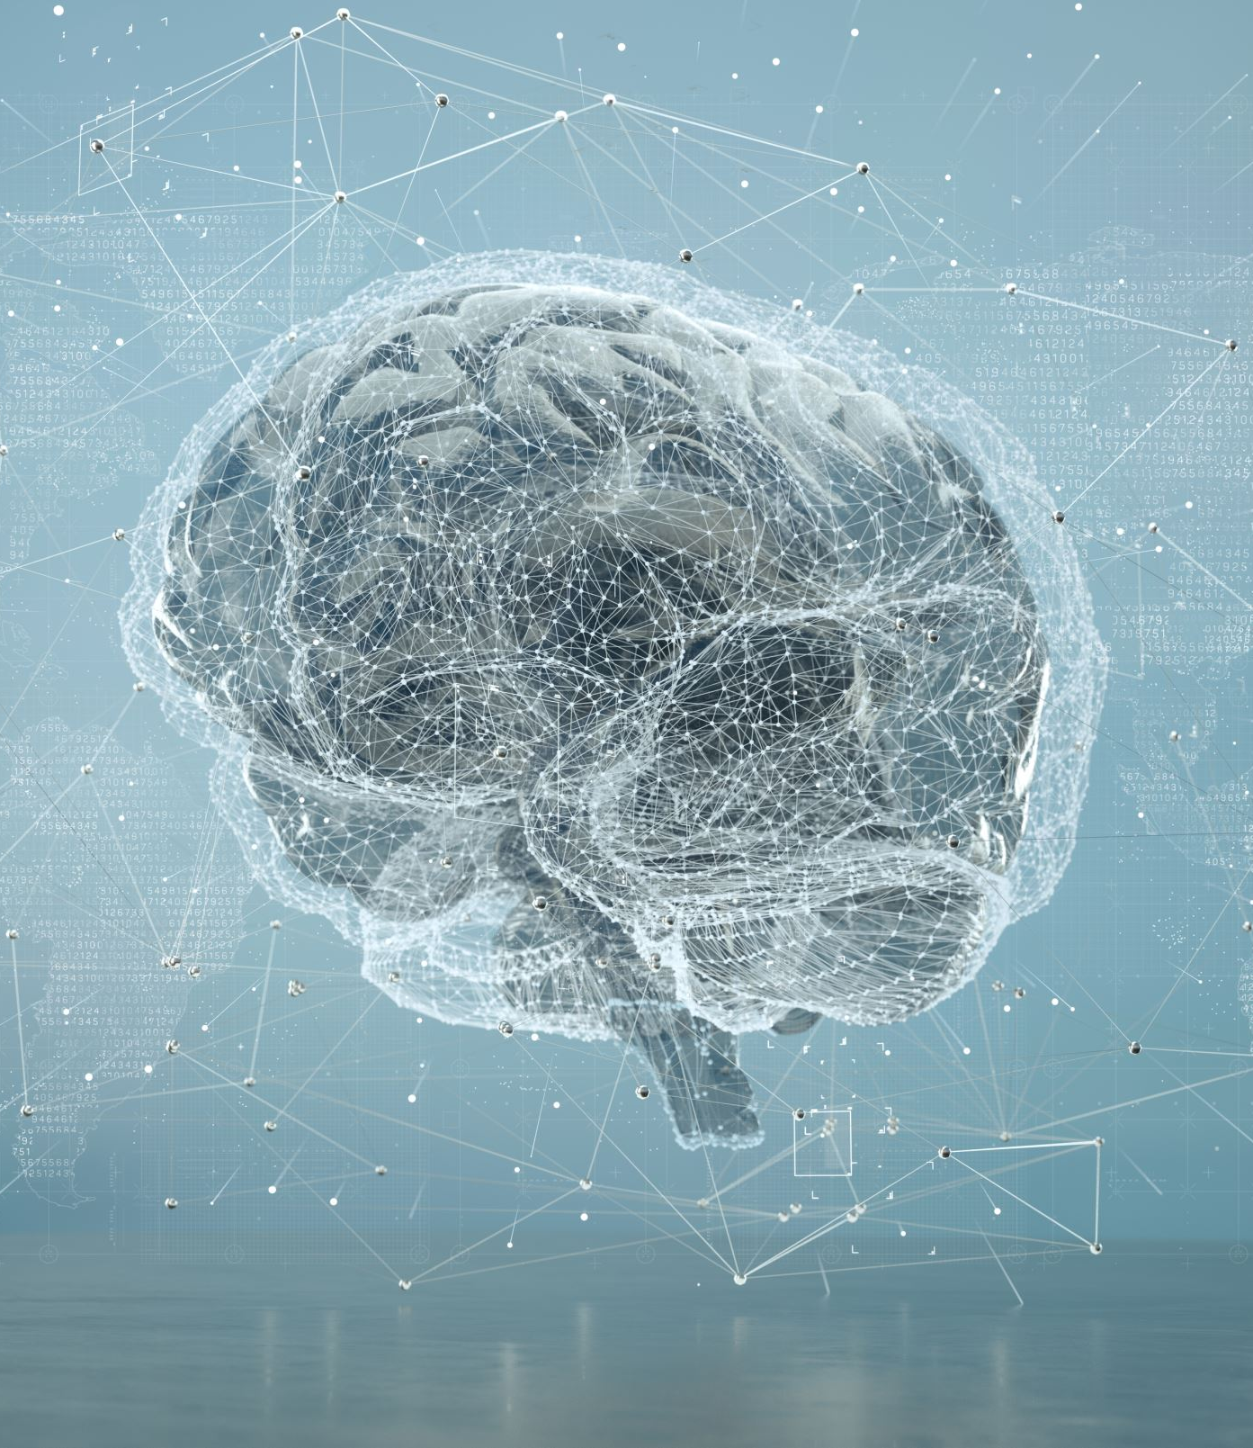
Deep learning and Neural Networks: Overview
Track module I
Ekaterina Golubeva
20.01.23

Slide 11
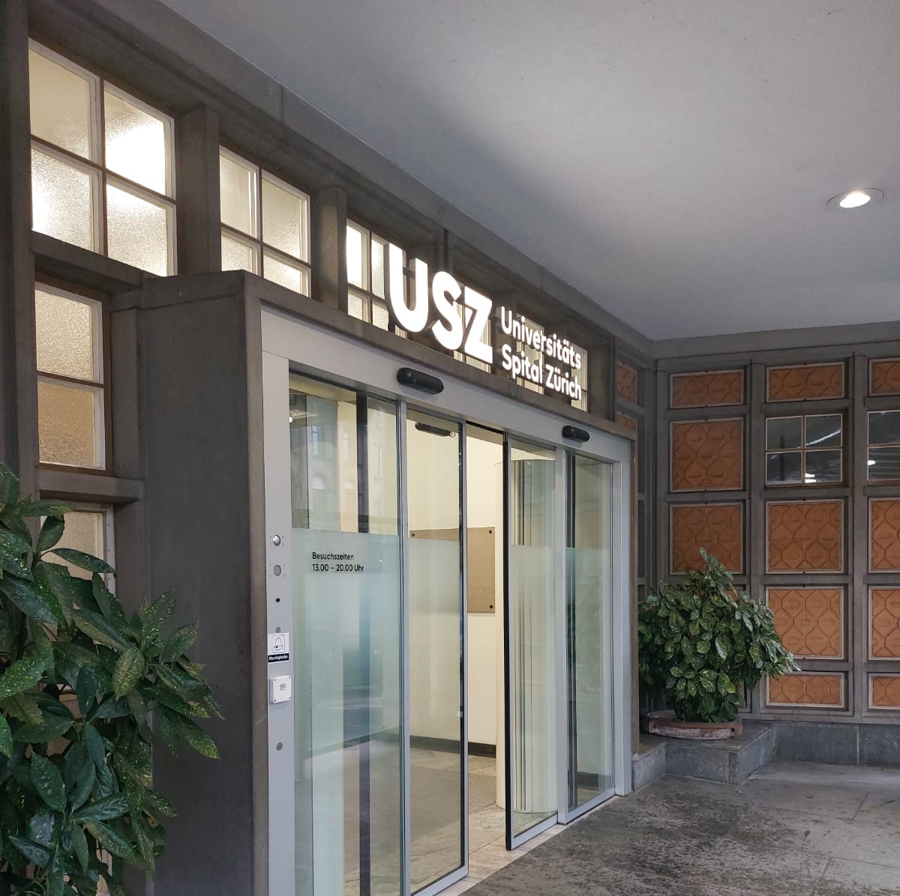
Visit of the Intensive Care Unit and Data analysis at USZ
Infrastructure
Data challenges
Delirium diagnosis and score
Processing and visualizing synthetic data
Plots analysis, statistics, EDA
Programming skills assessment

Slide 12
Wrap up
Basic image processing using Python libraries
Machine learning for image segmentation
Introduction to Deep learning and Neural Networks
Processing of tabular data

